Slide 1
MINI PROJECT ON MULTI-CHAT APPLICATION
SUBJECT – COMPUTER NETWORKS
SECTION – G2
TEAM MEMBERS:-
CHETAS SHREE MADHUSUDHAN(RA2011003011120)
Rishabh Dharmik (RA2011003011129)
E Sanju Rao (RA2011003011128)
Ishaan Soman (RA2011003011154)

Slide 2
MULTI-CHAT APPLICATION
Before years ago, people were liking to interact each other and sharing the thoughts, But nowadays trend is changed, youngsters are not believed in real relationship, but they liking to Live in Virtual world, due to the expansion of growth of internet facilities rapidly, So nowadays Chat grabs the internet market.
Objectives:
Our objective is to know about the various concept of Internet.
To know the various function of Java, that are used for internet connection.
To Spread the Basic knowledge of socket programming as we are the post graduate students.

Slide 3
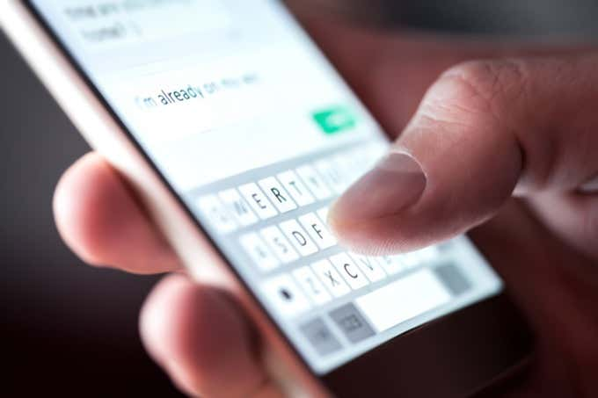
INTRODUCTION
Chat application is grabbed the market day by day. Number of chat applications are in the market like facebook, twitter, whatsapp, we-chat, mchat, Live chat, Go chat, chat on etc.
Facilities:
Text messaging
Voice messages
Video Calling
File Transfer(Video, Images etc.)
Smiley

Slide 4
INTRODUCTION TO UDP
UDP stands for User Datagram Protocol.
UDP is a communication protocol that is primarily used to establish low-latency and loss-tolerating connections between applications on the internet.
UDP speeds up transmissions by enabling the transfer of data before an agreement is provided by the receiving party. As a result, UDP is beneficial in time-sensitive communications, including voice over IP (VoIP), domain name system (DNS) lookup, and video or audio playback.
Features:
It allows packets to be dropped and received in a different order than they were transmitted, making it suitable for real-time applications where latency might be a concern.
It can be used where a large number of clients are connected and where real-time error correction isn't necessary, such as gaming, voice or video conferencing, and streaming media.

Slide 5
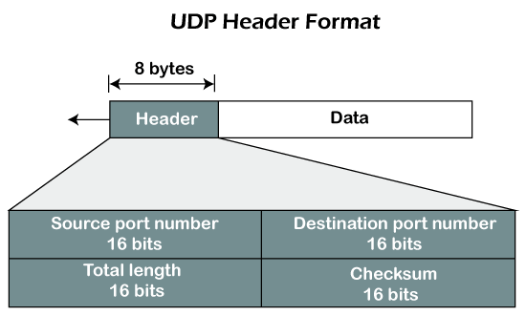
UDP HEADER COMPOSTITION
UDP uses headers when packaging message data to transfer over network connections. UDP headers contain a set of parameters -- called fields -- defined by the technical specifications of the protocol.
The User Datagram Protocol header has four fields, each of which is 2 bytes. They are the following:
Source port number
Destination port number
Length
Checksum

Slide 6
WORKING OF UDP
UDP uses IP to get a datagram from one computer to another. UDP works by gathering data in a UDP packet and adding its own header information to the packet. This data consists of the source and destination ports on which to communicate, the packet length and a checksum. After UDP packets are encapsulated in an IP packet, they're sent off to their destinations.
Unlike TCP, UDP doesn't guarantee the packets will get to the right destinations. This means UDP doesn't connect to the receiving computer directly, which TCP does. Rather, it sends the data out and relies on the devices in between the sending and receiving computers to correctly get the data where it's supposed to go.
Most applications wait for any replies they expect to receive as a result of packets sent using UDP. If an application doesn't receive a reply within a certain time frame, the application sends the packet again, or it stops trying.
UDP uses a simple transmission model that doesn't include handshaking dialogues to provide reliability, ordering or data integrity. Consequently, UDP's service is unreliable. Packets may arrive out of order, appear to have duplicates or disappear without warning.

Slide 7
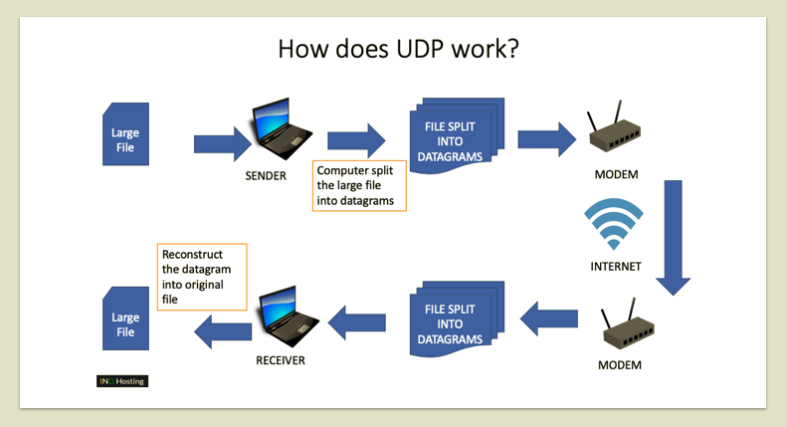
WORKING OF UDP

Slide 8
ARCHITECTURE & DESIGN
SERVER
A server may be a computer dedicated to running a server application. Organizations have dedicated computer for server application which has to be maintained periodically and has to be monitored continuously for traffic loads would never let them go down which affects the company’s revenue.
Most organizations have a separate monitoring system to keep an eye over their server so that they can find their server downtime before its clients. These server computers accept clients over network connections that are requested. The server responds back by sending responses being requested.
There are many different server applications that vary based on their dedicated work. These server computers must have a faster Central processing unit, faster and more plentiful RAM, and bigger hard disc drive. More obvious distinctions include redundancy in power supplies, network connections, and RAID also as Modular design.

Slide 9
ARCHITECTURE & DESIGN (cont…)
CLIENT
A client is a software application code or a system that requests another application that is running on dedicated machine called Server. These clients need not be connected to the server through wired communication. Wireless communication takes place in this process. Client with a network connection can send a request to the server.

Slide 10
IMPLEMENTATION
A static Server socket is created in beginning which is then bind with host and port.
After server instantiation Socket in particular host, it begins to listen in the particular port. Then the server is made to accept the request from the client through the particular port.
After starting the server, it can accept the requests from clients.
The socket is instantiated in client side to connect to the server.
A new Server Thread using socket is created to accept all the requests from multiple clients.
After accepting the request both read and write operation occurs simultaneously, clients who request the server can communicate with each other and share resources.
After finishing the communication the socket is closed both in the client and server side

Slide 11
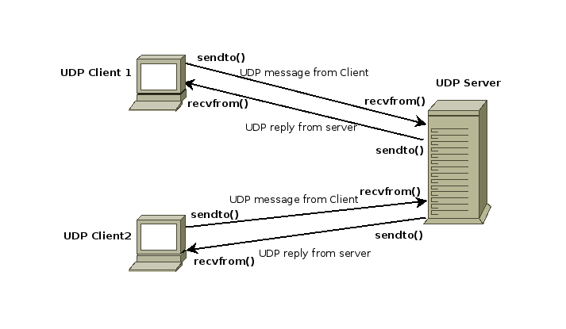
EXECUTION

Slide 12
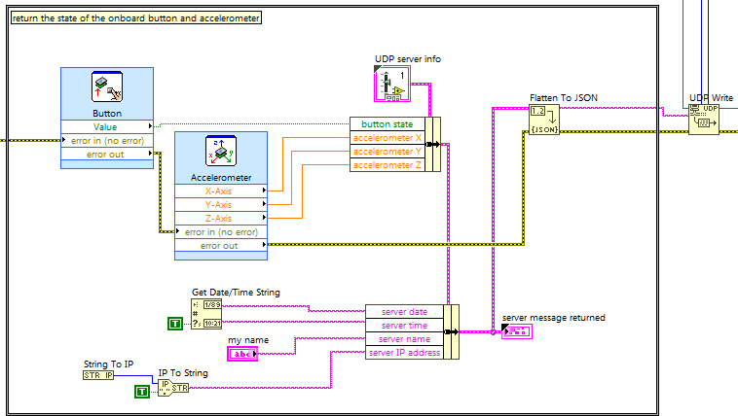
UDP Client-Server

Slide 13
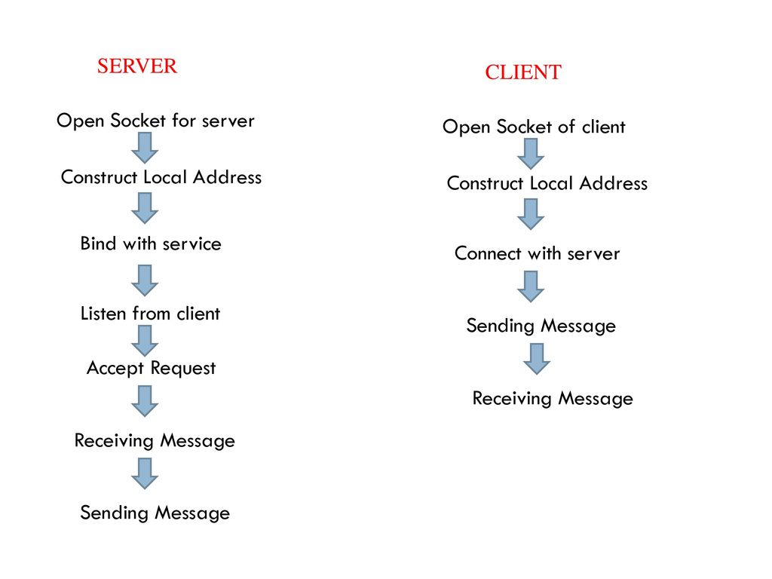
UDP Client-Server (cont…)

Slide 14
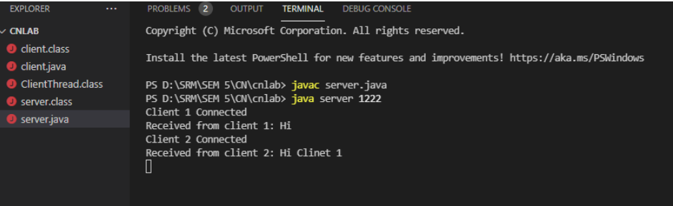
Results
Server

Slide 15
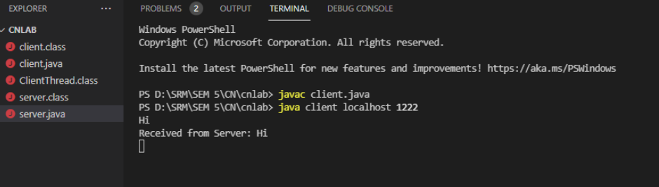
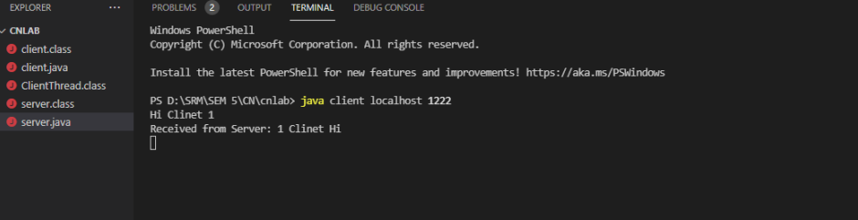
Client 1
Client 2

Slide 16
ANALYSIS
When any user sends the message it is sent to all the receivers along with the anonymous name. Maximum user count is set to which the user can get connection.
Once the client count exceeds the server intimates that server is busy and the client will wait until the server becomes idle. Any user can leave the chat box once it sends the message.
Once the sender leaves it will be removed from the chat and all other users will be informed about it.
Once the user leaves the chat box other users which are waiting for server to become idle will get a chance to communicate. Instead of sending message to all the users in the chat box message can be forwarded to particular user.

Slide 17
CONCLUSION
The chat application provides a better and flexible system for chatting. It is developed with recent advanced technologies in a way to provide a reliable system.
Main advantages of the system are instant messaging, real-world connectivity, adding security, group chat, etc. This application can find better need in the market for most of the organizations aim at having private applications for them.
Additional features will also be included in the system based on the public need which includes conference call, video chat. Location share, etc. based on the need

Slide 18
REFERENCES
https://www.ijeat.org/wpcontent/uploads/papers/v9i5/E9578069520.pdf
https://www.geeksforgeeks.org/multi-threaded-chatapplication-set-1/

Slide 19


